Slide 1
Planned ‘defections’

Slide 2
Problem structure
Start state where task can be tried which takes some effort. If tried, then leads to probabilistic transitions to easy or hard states which take different amounts of effort to finish the task
There is an option to shirk in each of these states

Slide 3
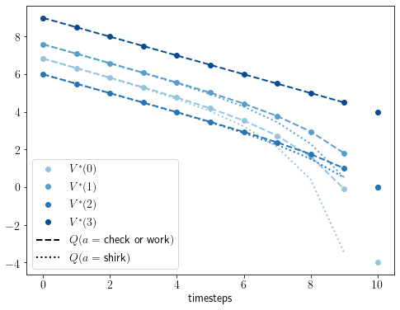
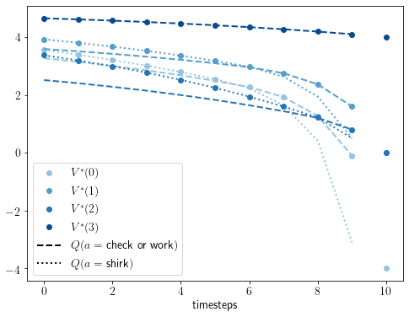
Without discounting, no delays in checking or working (abandon if costs are prohibitive) Discounting leads to delays
Efforts(check, work_easy, work_hard) = -0.1, -0.2, -1.0
Rewards(pass, uncompleted, fail, shirk) = 4.0, 0.0, -4.0, 0.5
Efficacy = 0.5; probability of transitions to easy and hard = (0.9, 0.1)
γ =1
γ =0.9
With discounting, in this param regime, checking on timestep = 6 and an unlikely transition to the difficult state means delaying working further until step = 9. So continuing working is delayed further due to unlikely hardness.

Slide 4
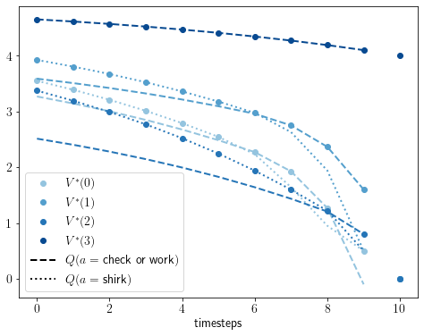
if consequences of failing not very high, then unnecessary to check in the final timestep
Reward_fail = 0.0

